Slide 1
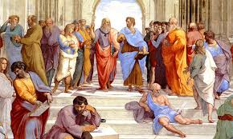
Plato

Slide 2
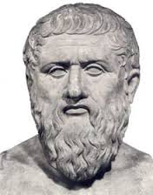
Plato’s Life
Plato is considered to be one of the greatest Western philosophers of all time.
We do not know exactly when he lived – approximately from 428 to 347 BC.
Plato was most likely born in Athens. He founded the Academy in Athens, one of the first institutions of higher education in the Western world.

Slide 3
Great Philosophical Age in Ancient Greece (part of the Axial Age)
Socrates (470/469 – 399 BC)
Plato’s teacher. Also the main character of most of Plato’s dialogues. Socrates was executed for the charge of corrupting the youth.
Plato (between 428 – 347 BC)
Aristotle (384 – 322 BC)
Plato’s student.

Slide 4
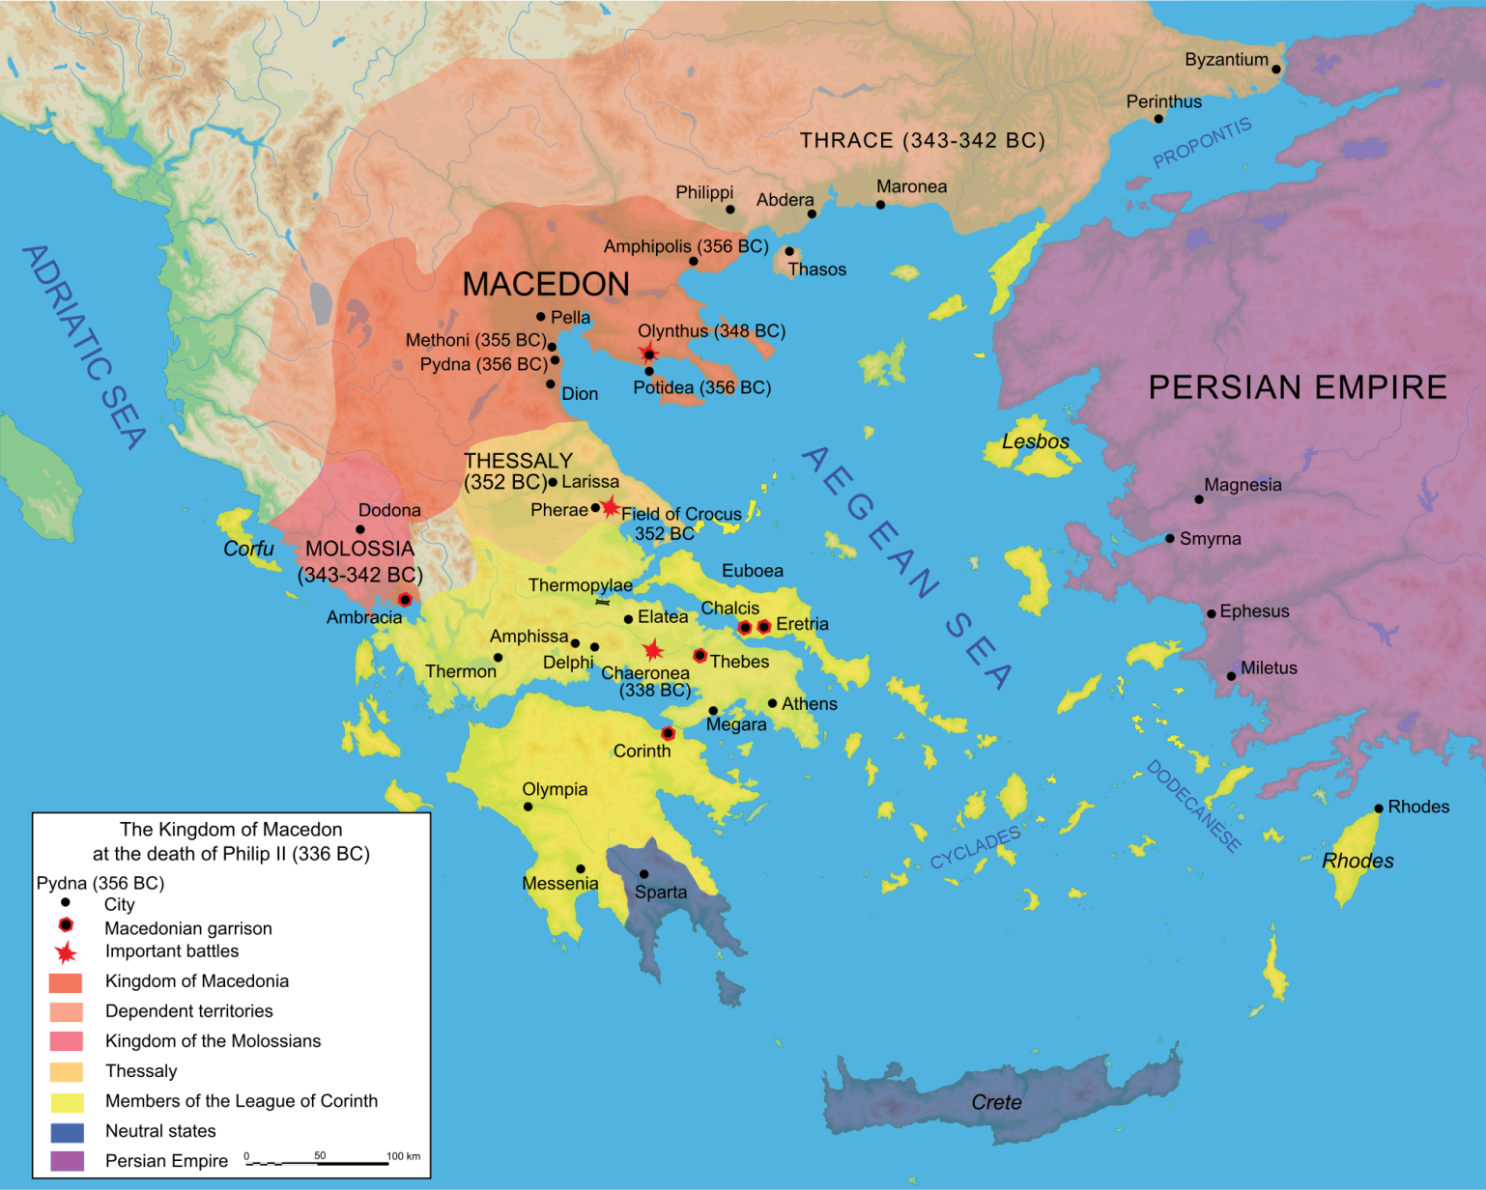
Map of Ancient Greece

Slide 5
Plato’s Writing
Plato’s work contains approximately 35 dialogues.
Plato’s writing style is unusual because his theories appear in the form of philosophical conversations, rather than essays or treatises.

Slide 6
Plato’s the Republic
Plato’s the Republic appears in the middle period of his work (approximately 380 BC).
It is by far the longest of his Socratic-dialogues.
Justice, politics, and the promise of a perfect city-state are some of the primary themes of the Republic.

Slide 7
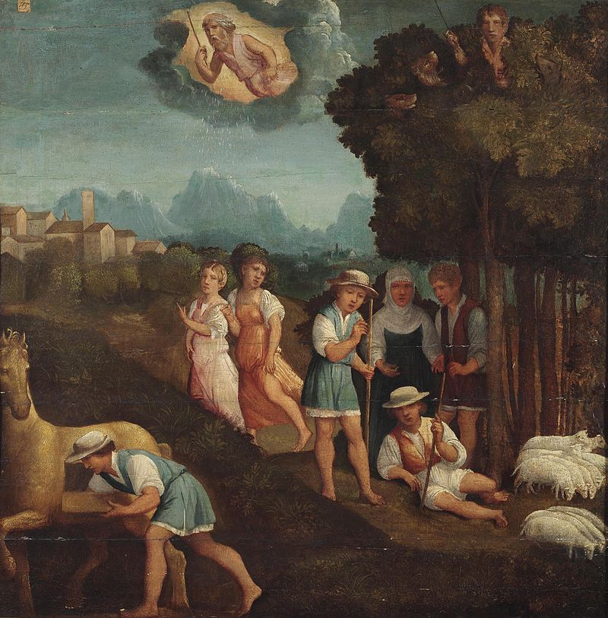
The Story of Gyges’ Ring
Painting from Ferrara, 16th century.

Slide 8
The Story of Gyges’ Ring
The story of Gyges’ ring appears in the second book of the Republic, as part of a long discussion between Socrates and Glaucon about the nature of justice. Historically, Glaucon is Plato’s older brother. He is the person who tells the story to Socrates.
Let’s read the story together. Here are some questions to keep in mind as we read:
1) Why does Glaucon tell this story to Socrates?
2) What is the main plot of the story?
3) Why does Glaucon claim that we only act well because we face consequences if we act badly?

Slide 9
Reading Strategy
You can read the passage as divided into three topics:
1) Glaucon articulates the theory behind his position on justice.
2) Glaucon tells Socrates the story of Gyges’ ring.
3) Glaucon offers a second hypothetical thought experiment, where there are two magical rings.

Slide 10
Glaucon’s theory of justice
Best
Worst
Glaucon claims that it is best “to do injustice without paying the penalty.”
Glaucon claims that the worst situation is to “suffer [injustice] without being able to take revenge.”

Slide 11
Justice is a mean between two extremes.
Better
Worse
Glaucon claims that it is better to act justly towards others than it is to act unjustly and to face penalty.
Glaucon claims that the threat of being punished for unjust actions is worse than the benefits we gain from acting unjustly.

Slide 12
Main Point
If there were no consequences to our actions, we would prefer to act unjustly because this serves our self-interest.
But since we are often unable to avoid punishment and retaliation for acting badly towards others, we set up a system of justice (agreements, contracts, laws) because it is better to act justly than to face the consequences from acting unjustly.

Slide 13
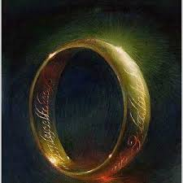
What is significant about the ring?
What does invisibility symbolize in terms of justice for Glaucon?
To become invisible is to be placed out of context.
It relieves us of all external consequences for our actions.

Slide 14
Two Hypothetical Situations
Hypothetical One
Hypothetical Two
Imagine there is a shepherd who finds a magical ring.
Once the shepherd has the ring, he acts unjustly towards others.
Now imagine that there are two magical rings, one for a just person and one for an unjust person.
Glaucon claims that the just person will become unjust once there are no consequences.

Slide 15
Therefore,
people only appear to be just. Justice is only the appearance of justice.

Slide 16
Therefore,
we do not naturally want to act well but are coerced by the laws we create to subdue our original nature. If we were able to take ourselves out of our social contexts, that is, if there were no consequences to our actions, we would act solely from our own interests, even if this means doing the most horrible things to others.
.

Slide 17
What is the best?
According to Glaucon, what is the best configuration?
The best is to appear to be just even though you are actually unjust. This is exactly what the shepherd of Lydia achieves by seducing the queen, killing the king, and becoming the king for himself.

Slide 18
Group Discussion
Explain the significance behind the first sentence of the passage:
“They say that to do injustice is naturally good and to suffer injustice bad, but that the badness of suffering it so far exceeds the goodness of doing it that those who have done and suffered injustice and tasted both, but who lack the power to do it and avoid suffering it, decide that it is profitable to come to an agreement with each other neither to do injustice nor to suffer it.”
Do you think that Glaucon is right about human nature? Do you find his argument persuasive?

Slide 19
Group Discussion
Explain the significance behind this quote:
“Someone who didn’t want to do injustice, given this sort of opportunity, and who didn’t touch other people’s property would be thought wretched and stupid by everyone aware of the situation, though, of course, they’d praise him in public, deceiving each other for fear of suffering injustice.”

